Slide 1

Presented by
Sarah Hanghujja Wabusa
BSC CS (MUK), MIS (UMU)
TO
UNHLS
AT HOTEL BROVAD.
Sarah Hanghujja (UMU)

Slide 2

Consider the role of Data Management (DM) within the Project Life Cycle.
It is important to plan effective DM at the project planning stage.
How negligence in DM can results in wrong decisions being made at policy level.
Sarah Hanghujja (UMU)

Slide 3

To introduce the basic concepts: Data management, Data Archiving, Data threats & Data security
To identify the stakeholders in Data Management
To outline the stages and levels of Data management
To equip participants with skills to manage their data
Sarah Hanghujja (UMU)

Slide 4

Data management is the development and execution of architectures, policies, practices and procedures in order to manage the information lifecycle needs of an organisation in an effective manner.
Data Management is the process of administering data as a resource that is valuable to an organisation or business.
It should be corporate responsibility that DM needs to be addressed and followed from the upper most senior levels of management to the front line workers.
Sarah Hanghujja (UMU)

Slide 5
Data Management is concerned with “looking after” and processing data which will involve:
  Looking after field data sheets.
  Entering data into computer files.
  Checking and correcting the raw data.
  Preparing data for analysis.
  Documentation.
  Backing up and archiving the data.
  Data recovery.
  Data security.
  Data sharing (Stakeholders)
  Part of that responsibility lies in training the employees to become familiar with the organisation’s policies, processes, technologies and best practices in data management.
Sarah Hanghujja (UMU)

Slide 6

Ensures data for analysis are of high quality so that decision making is faster due to easy data retrieval.
Future reference- Allows further use of the data in the future and enables efficient integration with some other data.
Predictions and planning for the organization.
Threats are on the increase
Damage to reputation.
Confidentiality and sensitivity of data (Laboratory results).
DM is a threat to money loss (funding).
Sarah Hanghujja (UMU)

Slide 7

Lack of necessary skills
Multiple copies of files
No one with responsibility for checking data
No clear policy on archiving or making data available to stakeholders
Lack of documentation
Multiple entry of the same data
Hand pre-processing of data
Sarah Hanghujja (UMU)

Slide 8

  Clearly defined roles for staff
  A regular backup procedure
  Details of data quality checks
  Include DM on the agenda of project meetings
  Procedure for upgrading software
  Details of how archive is to be produced
  Details of how the archive is to be maintained
  outline the stakeholders.
  Principles of data retrieval.
  Data security.
Sarah Hanghujja (UMU)

Slide 9
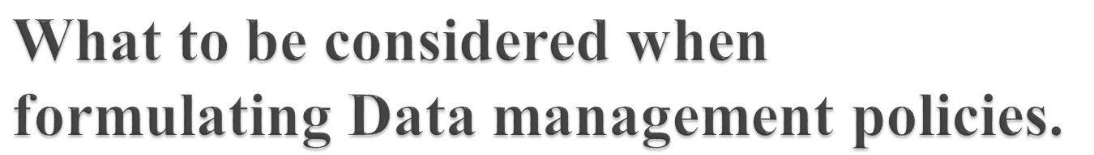
No specific rules to data management
Data Access and audit trials
Data presentation
Restricted data
Data archiving
Providing for open data.
Copyright and Intellectual property rights.
Feedback mechanisms.
Updating data sets
Data validation
Data encryption
Sarah Hanghujja (UMU)

Slide 10

  Have you encountered similar situations in your own workplace?
  Discuss a feasible data management Policy in your workplace
Sarah Hanghujja (UMU)

Slide 11

  The practice of moving data that's no longer being used to a separate storage device.
  Data archives protect older information that is not needed for everyday business operations but may occasionally need to be accessed.
  An effective data archiving policy/ strategy is a necessary part of every IT organization.
  Data archiving in not data backup.
Sarah Hanghujja (UMU)

Slide 12

Identify the data to be archived.
Identify the data life cycle management.
Create an archive policy for ages.
Archiving criteria: search, automation, flexibility
Sarah Hanghujja (UMU)

Slide 13

Data Security the process of keeping data secure and protected from not only unauthorized access but also corrupted access.
Data threat is anyone or anything that causes danger to data.
Sarah Hanghujja (UMU)

Slide 14

Disgruntled Employees
Careless Employees
Mobile Users
Outdated Software
Viruses and worms
Network threats
Sarah Hanghujja (UMU)

Slide 15

Log off your computer whenever not in use
Level of access- requiring logins/passwords to access computer/ network assets
Use of Passwords
Backup (Servers)
Virus Protection
Use of firewall
UPS (Uninterruptible Power Supply) unit
Lock the room whenever not in use.
Sarah Hanghujja (UMU)

Slide 16

Its only when information is shared that more ideas are generated.
Sarah Hanghujja (UMU)

